Slide 1
CSS3 Cascading Style Sheets
Adding Style to your Pages

Slide 2
Browser Default Styling
The same html file may look different when viewed on different browsers.
Some tags are supported, some aren’t
Browsers may have different default styles
In general, default looks are plain.

Slide 3

Adding Style
As styling tags were phased out of html, styling was done with style attribute
Violated separation of content/style

Slide 4
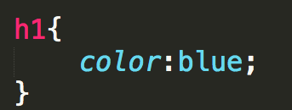
Cascading Style Sheet
CSS defined generic rules that can apply to multiple elements
selector {
property: value;
}

Slide 5
Rule Syntax
Brackets and semicolons are very important
This is where a good editor can make a BIG difference

Slide 6
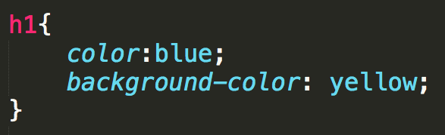

Multiple Properties

Slide 7
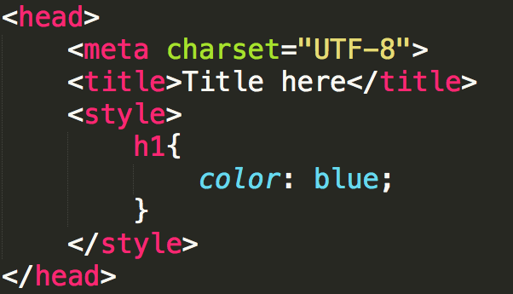
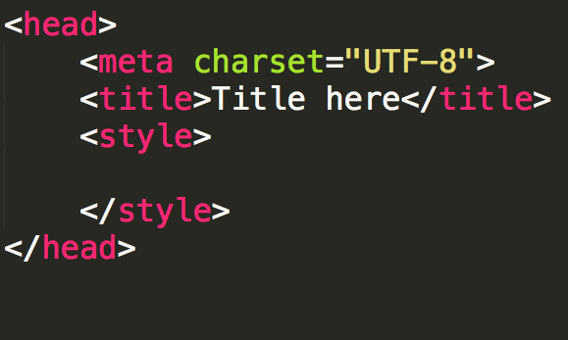
Internal Style Sheet
Styling is defined within <head>
Rules are defined within <style>
Styles are applied to all elements in that file
Don’t forget to close the style tag!!

Slide 8
External Style Sheet
You can put rules in an external file (don’t use the style tag!!)
A link to the style sheet is put in the head section.
Styles are applied to all elements in all files that links to the style sheet

Slide 9
The “Cascading” part of CSS
Browser default
External style sheets
Internal style (in the head section)
Inline style (inside an HTML element)

Slide 10
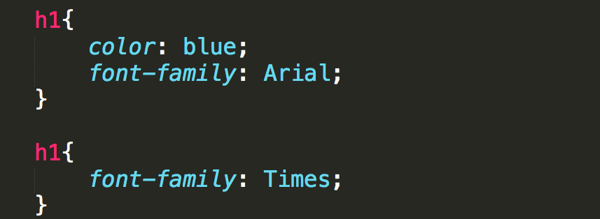
Rule precedence
What if one selector is defined in two external files?
The rules from the most recent file have precedence
What if one selector has more than one rule in the same file?
The most recent rule has precedence

Slide 11
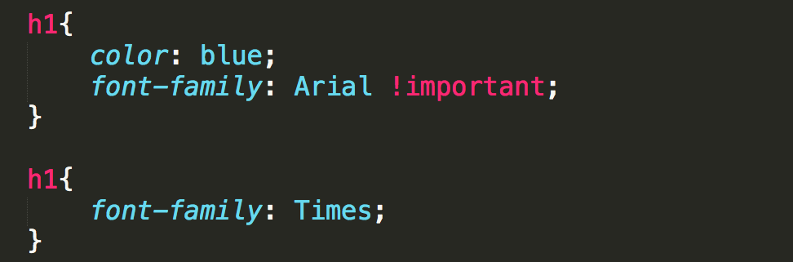
!important
It is possible to override later rules, use
!important

Slide 12
Review
Why do we want/need to separate content from formatting?
How does this also tie in to external/internal style sheets?
Understand that this is very powerful. See http://www.csszengarden.com/

Slide 13
Designing for Accessibility
POUR

Slide 14
Overview
The content of your page should be in the HTML.
It is tempting to add content via colors, images, etc.
Follow the POUR guidelines
Perceivable, Operable, Understandable, Robust

Slide 15
Perceivable
Provide text alternatives for images
Provide captions and transcripts for video and audio
Use correct semantic markup so content can be presented in different ways
Make it easier for users to see content by using good color contrast

Slide 16
Operable
All functionality available from the keyboard!
Users have control over timing and limits
Do not cause seizures (don’t flash content)
Provide ways to help users navigate, find content, and determine where they are

Slide 17
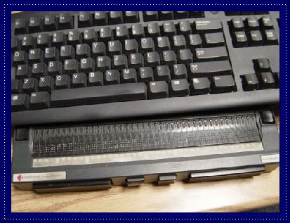

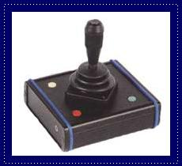
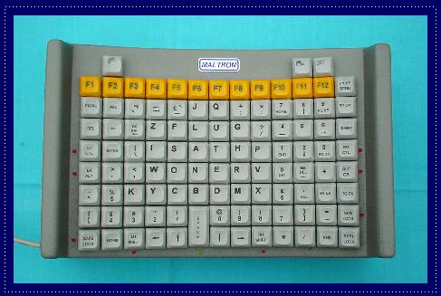
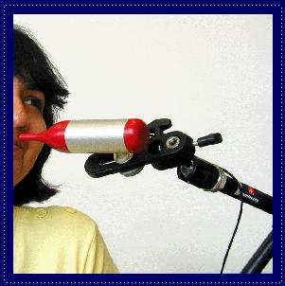

Slide 18
Understandable
Economical and plain use of language
Text supplemented with illustrations, videos, and other formats where appropriate (i.e., use good Universal Design)
Navigation, information structure are discernable and consistent
Make pages operate in predictable ways
Help users avoid and correct mistakes
Notes:
Chunking appropriately, avoiding jargon or institutional language, avoid URL descriptors
Different learning modalities, visual versus verbal
Don’t change nav and layout structure
Careful with AJAX-y elements, pop-ups
Considerate form validation and error correction

Slide 19
Robust
Is your site functional across various technologies (smart phone, screen reader, laptop, pensticks, etc..)?
Syntax errors that don’t affect visual presentation may hamper assistive technology and accessibility tools
Adhering to W3C standards ensures future compatibility
Validate your code at validator.w3c.org and wave.webaim.org

Slide 20
Review
Accessibility starts with proper HTML tags
Styling can actually make it HARDER for some people to access the information
Get into the early habit of utilizing accessibility tools
“Cool” new style should not be at the cost of accessibility

Slide 21
Advanced Selectors

Slide 22
Styling Specific Objects
We have focused on type selectors.
What if you don’t want to style all of the links, just some? Or just some of the lists?
CSS gives you options

Slide 23
CSS Selectors
Some selectors follow the DOM
Descendant selectors (nav a)
Style all of the anchor links inside a nav tag
Child selectors (nav > a)
more constraining The anchor elements must be a child of the nav, no intermediate tags, e.g. paragraph
Adjacent sibling (h1 + o)
elements must be at same level and follow each other

Slide 24
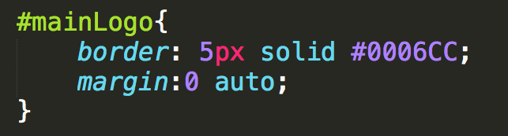
id Selectors
# id selector
Used to identify a single element in the DOM.
Was used extensively for <div id = “header”>, <div id=“footer”>, etc.
There is a small movement to move the use of id OUT of CSS

Slide 25
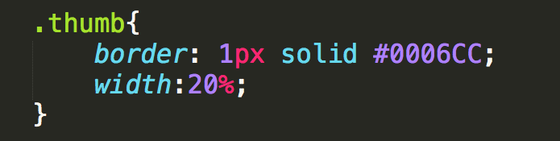
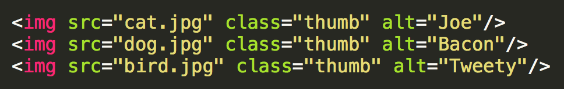
class Selector
. class selector
Used to identify an element in the DOM that is part of a special class of items
Think of thumbnail images, all of the links that are in the navigation, your social media images, etc….

Slide 26
classes vs. ids
Syntax is “.” and “#”
classes can be used multiple times
id should be unique
ids take precedence over classes in styling (see more later)

Slide 27
Narrowing the Scope
As you get more advanced pages, you will want to narrow the scope of the of action
p.main → paragraphs using main class
header img.special → paragraphs inside header that use special class

Slide 28
Expanding the scope
You can combine elements with a comma
p, h1, #main, .special{…rules to apply to all of them…}

Slide 29
More Attribute Selectors
Universal
* applies styling to every element on the page
Ackk!! Try this!
Attribute Selectors
a[href=‘info.html’]
PseudoClasses
Pseudo Elements

Slide 30
Attribute selectors
You may want to search the DOM for certain elements that have an attribute you are looking for
All the images that use gif files…..
All of the images that have empty alt text….
All of the links that go to government sites….

Slide 31
Using Operators
Operators can be used to find those attribute values you are looking for
^ : match the beginning exactly
a [href^=‘http://umich’]
$ : match the end exactly
img[src$ = ‘.png’] → apply to .png images
* : wildcard
a [href*=‘umich’]

Slide 32
Example
Examples:
AdvancedSelectors.html
AdvancedSelectors2.html

Slide 33
Rule Specificity
Each rule has a weight made up of four digits. Calculate using this formula
For each element and pseudo-element – add 1
For each attribute, class or pseudo-class - add 10
For each id - add 100
If the style attribute is used – add 1000.

Slide 34
Specificity example (https://www.w3schools.com/css/css_specificity.asp)
h1 { }
#content h1 { }
.intro {}
<div id="content"><h1 style="color: #ffffff">Heading</h1></div>

Slide 35
Whew!!!
We have actually covered a lot in this short video
Know that each of these ideas can merge. One element can have many classes and ids associated with it
Browser “starts at the top” and applies each rule, sometimes overriding earlier rules.

Slide 36
The Good News
You can use style sheets from others to style your code, just by adding class!!
You can override style sheets from others just by rewriting the class, or making your own version of it and linking it last.

Slide 37
Review
Type selectors can be combined to narrow the scope of where rules are applied
An id is used to specify a specific element in a page
Classes can be used to associate elements that should treated in a similar manner
Notes:
http://codepen.io/shayhowe/pen/FrCHn

Slide 38
Styling Links and Lists

Slide 39

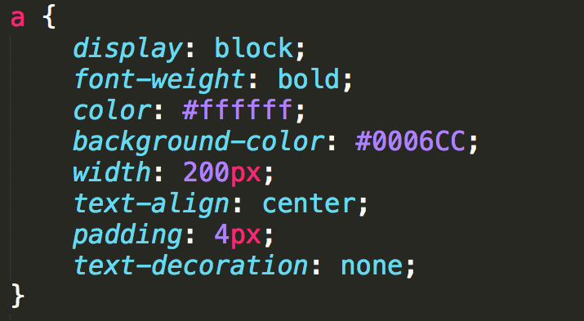

Anchor Links
Links can take on all of the usual styles as well as text-decoration

Slide 40


“Buttons”
Many designers try to make their links look like buttons.
Be semantic, if you want a button use the <button> element instead.

Slide 41
States
Some links are blue, some are purple, etc. Why???
a:link: a normal, unvisited link
a:visited: has been visited
a:hover: activated by mouse (touchscreens….?)
a:focus: activated with the keyboard
a:active: is being clicked

Slide 42
Precedence of Rules
a:hover MUST come after a:link
a:visited and a:active MUST come after a:hover

Slide 43
Styling Lists
Number of properties beyond font, margin, etc.
list-style-type
list-style-image
list-style-position
list-style

Slide 44
Example
Examples:
lists.html
links.html

Slide 45

Pseudo-Classes
Elements that are dynamically populated or dependent on tree structure
You have seen this before…

Slide 46
Types of Pseudo-Classes
Link
:link, :visited
User Action
:hover, :active, :focus
Forms (interfaces)
:enabled, :checked, :disabled

Slide 47
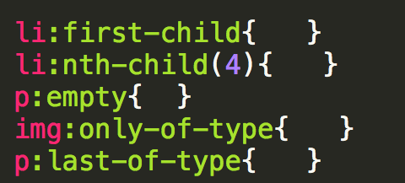
Types of Pseudo-Classes
Structural/Positional
:first-child, :last-child, :nth-child(), :only-child
:first-of-type, :last-of-type, :only-of-type

Slide 48
Pseudo-Elements
These elements aren’t part of the DOM
Can be used to style specific (unique) parts of the page

Slide 49
Types of Pseudo-Elements
Textual
:first-letter, :first-line
Positional/Generated
:before, :after
Fragments
::selection

Slide 50
Review
Embrace the many tools that are available to help you design your site.
Inspect element
http://chrispederick.com/work/web-developer/
http://css3generator.com/

Slide 51
Colors
Using the best colors for your site

Slide 52
Color Conventions
Color names (blue, red, yellow, etc.) work, but should be avoided
Hexadecimal is common convention
#0000FF, #FF0000, #FFFF00
rgb
(0, 0, 1), (1, 0, 0), (1, 1, 0)
rgba
(0, 0, 1, .5)
#0000FF
#FF0000
#FFFF00
rgb(0,0,1)
rgba(0, 0, 1, .5)

Slide 53
Accessibility
Appropriate use of color is critical to web accessibility
Many more people are visually impaired or color blind than are legally blind

Slide 54
What is color contrast?
You intuitively know when something has poor contrast
There are tools that quantify the contrast between text and its background
http://wave.webaim.org/
http://webaim.org/resources/contrastchecker/

Slide 55
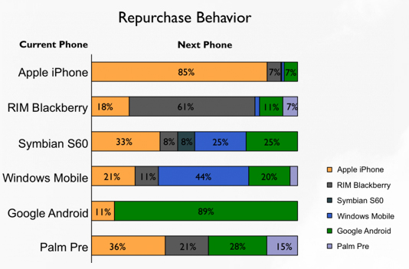
Don’t use color alone to convey meaning

Slide 56
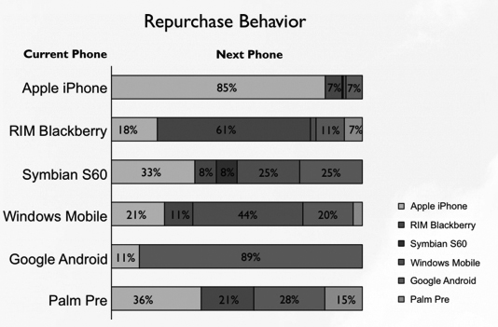
Test in gray scale …

Slide 57
Review
Use web safe colors and use an accepted convention
Test your site using a contrast checker
Avoid using color to convey meaning

Slide 58
Styling Your Text
Styling your text

Slide 59
Options
Many options for styling your text:
font (family, style, variant, size)
color and background
alignment
line-height

Slide 60
font-family
Font families are styles of text
Examples:
Helvetica, Courier, “Courier New”, “Comic Sans MS”, cursive, Verdana

Slide 61
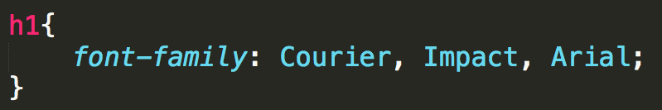
font-family
Not all font-families supported by all of the operating systems, so you can provide alternatives.

Slide 62
Google Fonts
There are almost 1000 additional fonts available through Google fonts
<link href='https://fonts.googleapis.com/css?family=Anton’
rel='stylesheet’>
<style>
body {
font-family: 'Anton';
}
https://www.w3schools.com/howto/howto_google_fonts.asp

Slide 63
Accessible Navigation

Slide 64
Navigation
Navigation is a critical aspect of accessibility
Sighted users have tried and true visual cues to orient them on a page
Banner
Search box
Main navigation box
Content well
Blind and low-vision users rely on proper coding of page for orientation
Notes:
Why can’t I animate the last bullet correctly?!?!?

Slide 65
What if you can’t see?
Title of page lets you know what page you’re on when page loads
Proper heading placement and hierarchy conveys organization of page and allows SR users to skip navigation
Link descriptions convey content of page and organization of site
Notes:
What are those holds?

Slide 66
Proper <h1> heading
Screen readers can find and list headings
<h1> heading uniquely identifies the page in the website
Should be placed directly in front of the main content of the page
The <h1> header should also match at least a subset of the the page <title>

Slide 67
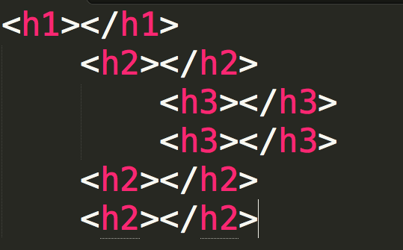
Proper heading hierarchy
Headings need to be properly nested to convey organization of the page
<h2> tags follow the <h1> tag, the <h3> tags follow the <h2> tags, etc.
Notes:
Don’t select heading levels for their default size—use CSS to style your headings.

Slide 68
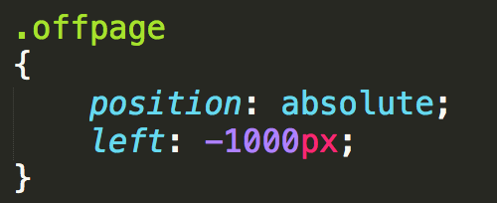
Off-page headings
Useful when you want to give SR users a navigational aid without cluttering presentation
Use CSS to position headings off-page
Don’t use {display: none} or {visibility: hidden}

Slide 69
Meaningful link text
Screen readers can find and list links
Descriptions for the links must be meaningful out of context, via tabbing or presented in a list
Don’t use “here”, “click here”, “read this”, and “more”
Don’t use URL as a link description—will sound like gibberish, unless very short and intuitive

Slide 70
Review
How easy is it to navigate your page?
What would happen if the colors weren’t there?
What would happen if you couldn’t use a mouse?
Plan for everyone

Slide 71

Acknowledgements/Contributions
These slides are Copyright 2015- Colleen van Lent as part of http://www.intro-webdesign.com/ and made available under a Creative Commons Attribution Non-Commercial 4.0 License. Please maintain this last slide in all copies of the document to comply with the attribution requirements of the license. If you make a change, feel free to add your name and organization to the list of contributors on this page as you republish the materials.
Initial Development: Colleen van Lent , University of Michigan School of Information

